Slide 1

2014.11.20
2014.12.03
2014.12.03
Project Name
Project Name
Project Name
By Your Name
By Your Name
By Your Name
Adding Printer in Clone Trooper
Sarath Kumar.M
2021/11/17

Slide 2
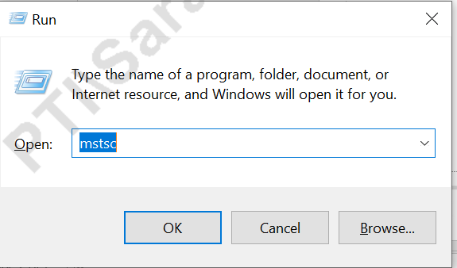
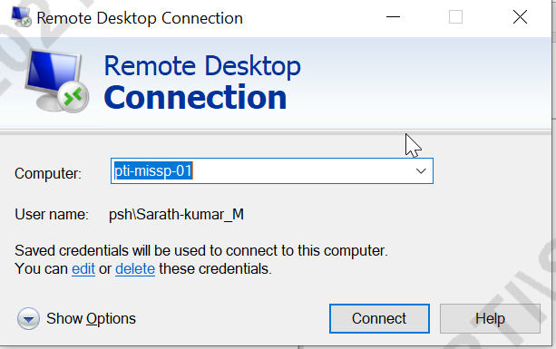
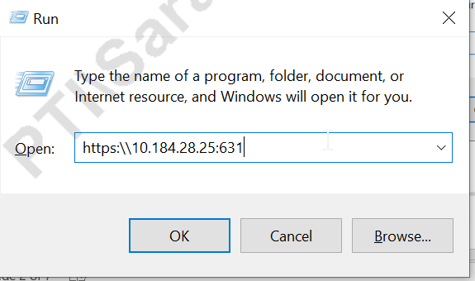
OPEN REMOTE SERVER # 1
OPEN REMOTE SERVER RUN-> MSTSC->pti-missp-01 click connect as given in fig 1 and fig 2.
Type the IP address of Clone Trooper in Run Command and click enter as given in Fig 3
1
2
User name : sfis
PWD : sfis_user_sh
DONT CHANGE THE CASE
3

Slide 3
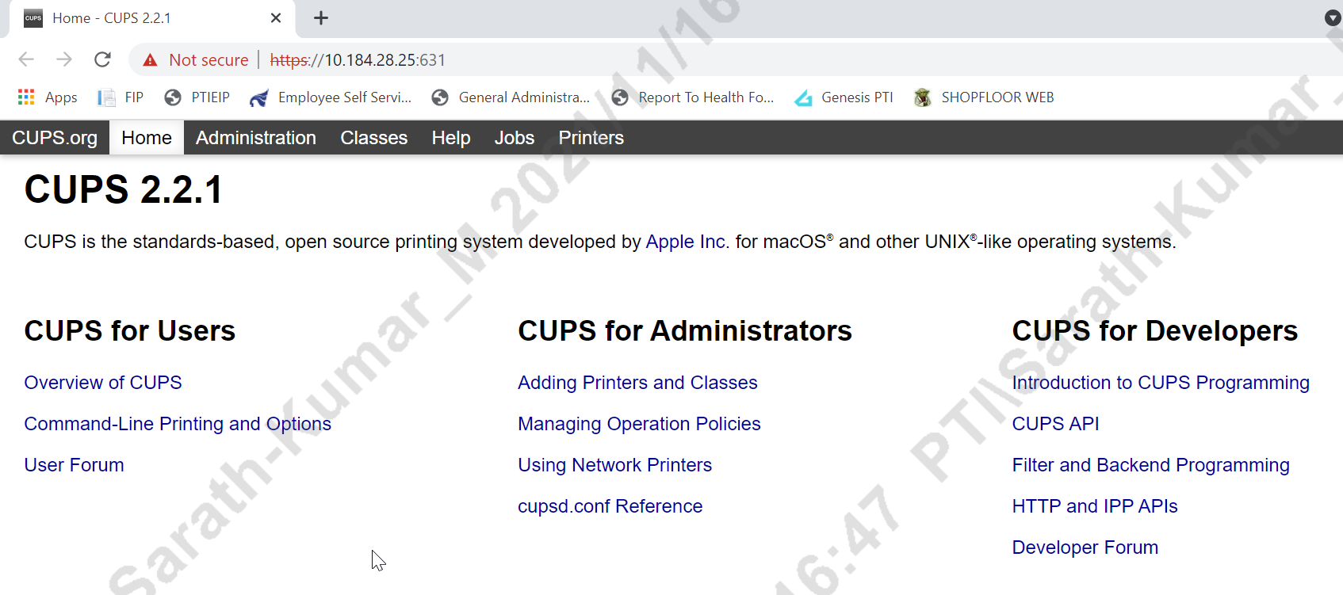
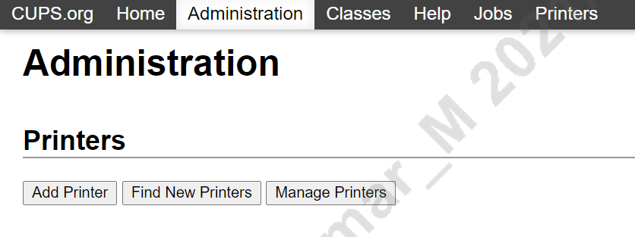
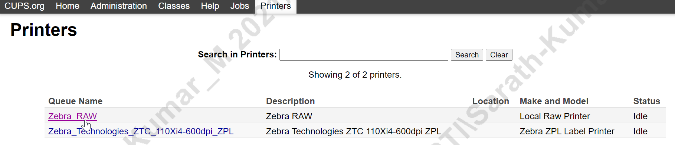
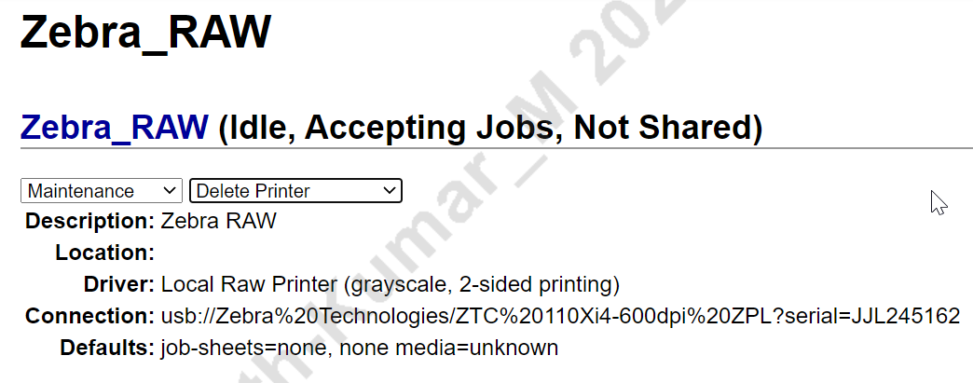
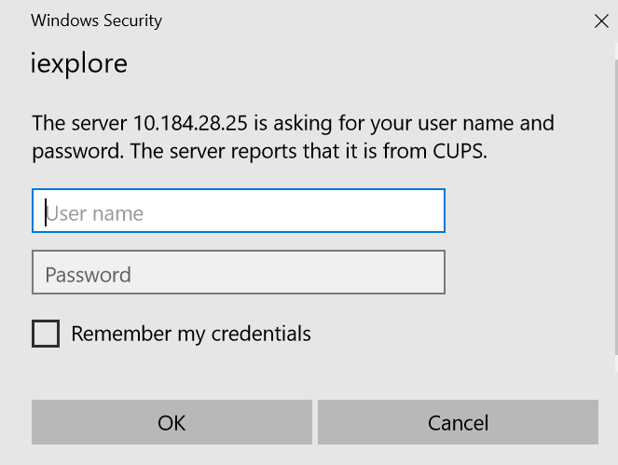
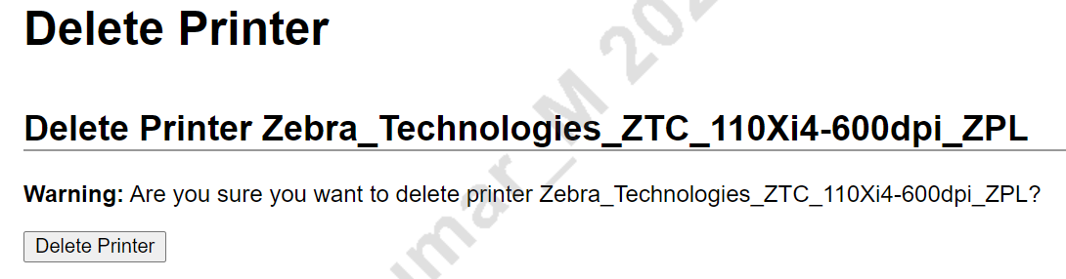
REMOVE PRINTER #2
Click Adding Printer and its open new window click Manage Printers and remove the printer as shown in Fig.
1
2
3
Once Select Delete Printer from drop down list need to login to remove the printer as shown Fig
4
5
6

Slide 4
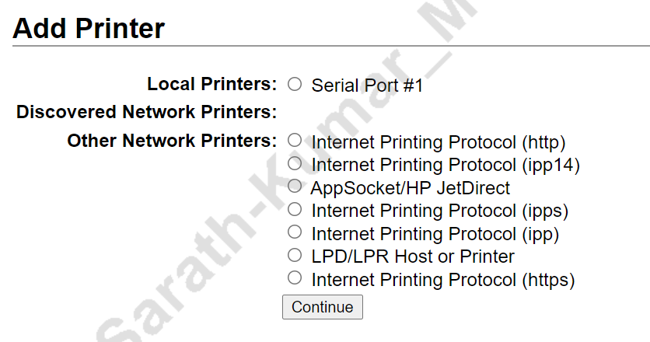
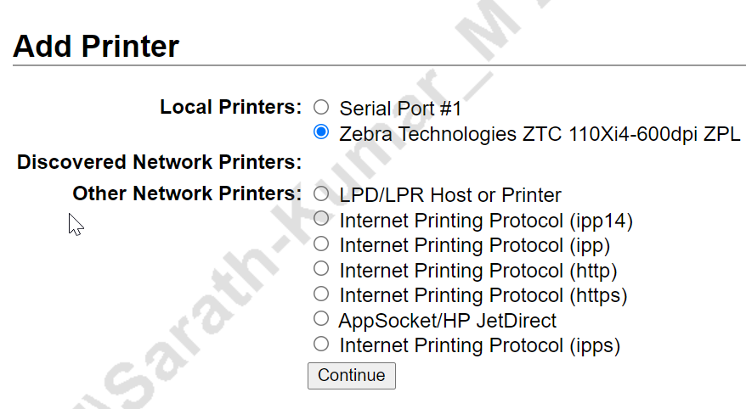
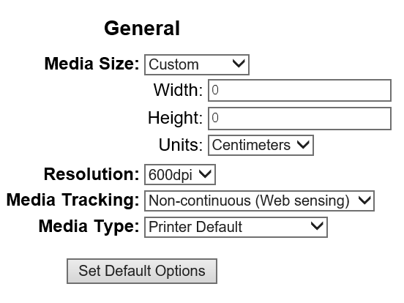
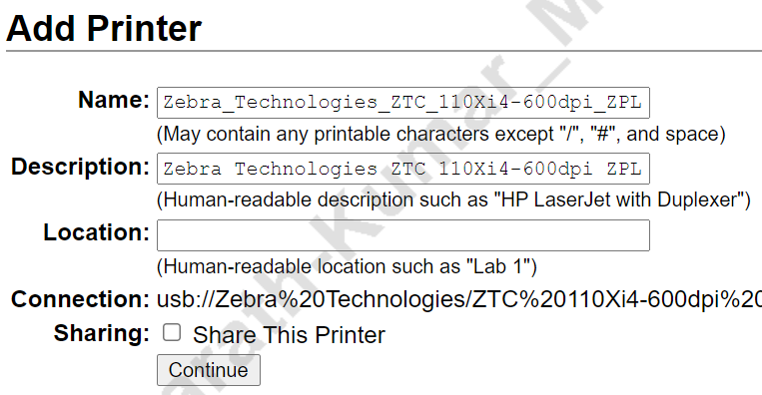
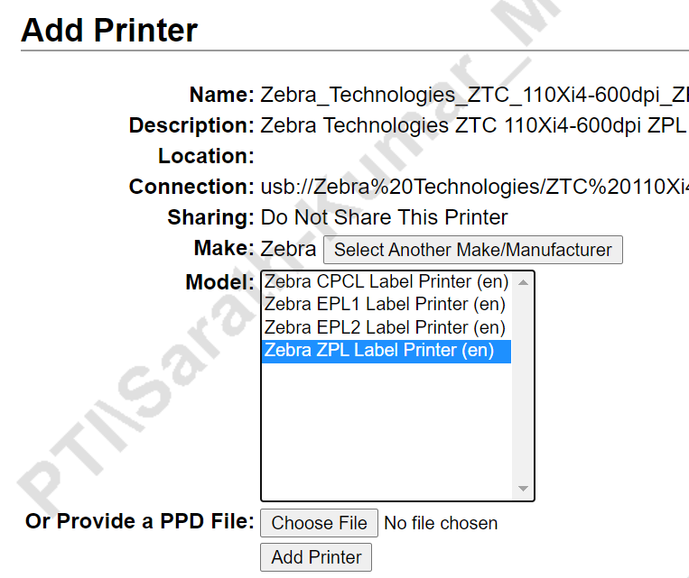
ADDING PRINTER (ZEBRA)#3
Click Add Printer and Check Clone Trooper & Printer Connected with USB. If it not connected we not able to see the device under local printer. Select
1
2
3
Before Connecting USB
After Connecting USB
We ned to Add two printer drivers as below “1.ZPL Driver & 2.RAW Driver”
After selecting printer click continue,select ZPL code, change media as custom,Width & height will be change based on label (attached Excel),units as centimeters resolution based on printer (300dpi or 600dpi) and click Set default option.
4
5
6

Slide 5
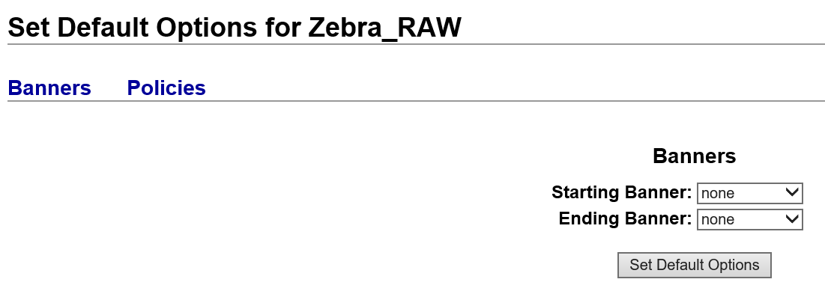
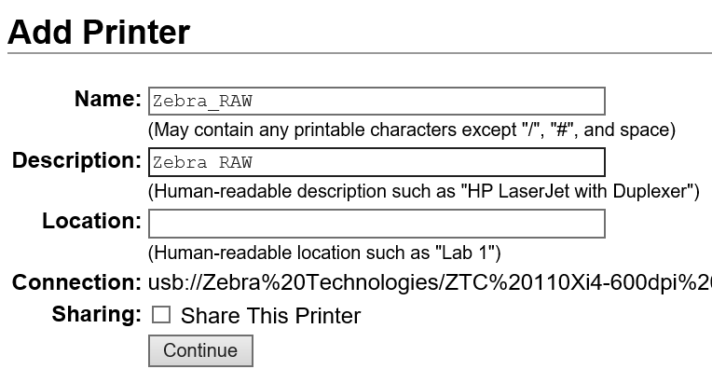
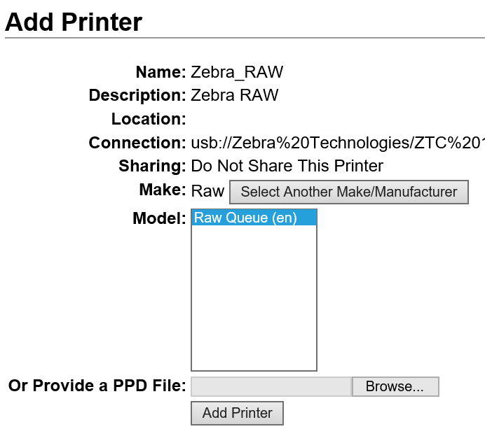
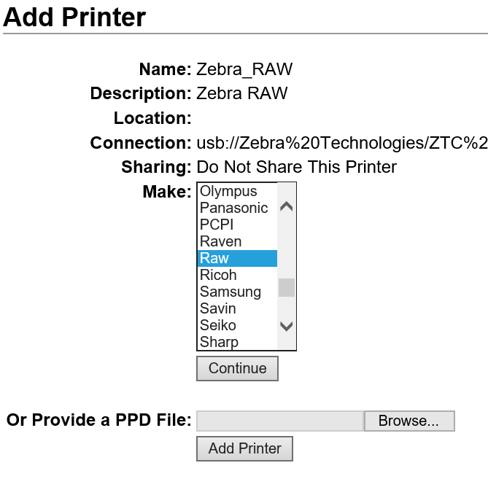
ADDING PRINTER(RAW)#4
Click Add Printer and Check Clone Trooper & Printer Connected with USB. If it not connected we not able to see the device under local printer. Select
1
2
3
Before Connecting USB
After Connecting USB
Need to change Name and Description as Zebra RAW ,then click another make and select RAW in drop downlist click add printer,no need to change anything in default option.
4
5
6

Slide 6
SET DEFAULT PRINTER
Click Zebra_Technologies_ZTC_110xI4-600DPI_ZPL window gets open in drop down set as default printer.

Slide 7
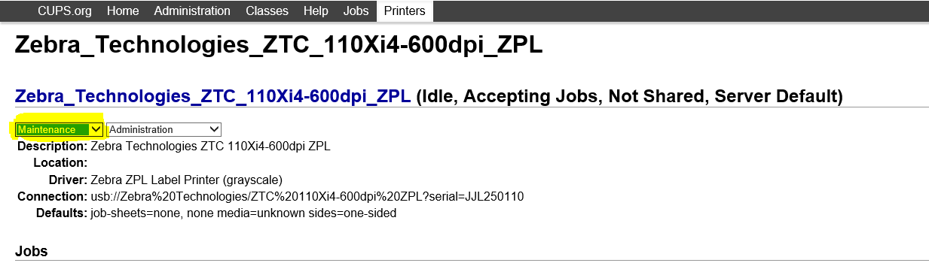
TEST PRINTER
Maintenace --> Print test page

Slide 8
LABEL ALIGNMENT
LABEL
+ (Label top)
- (LEFT POSITION)

Slide 9
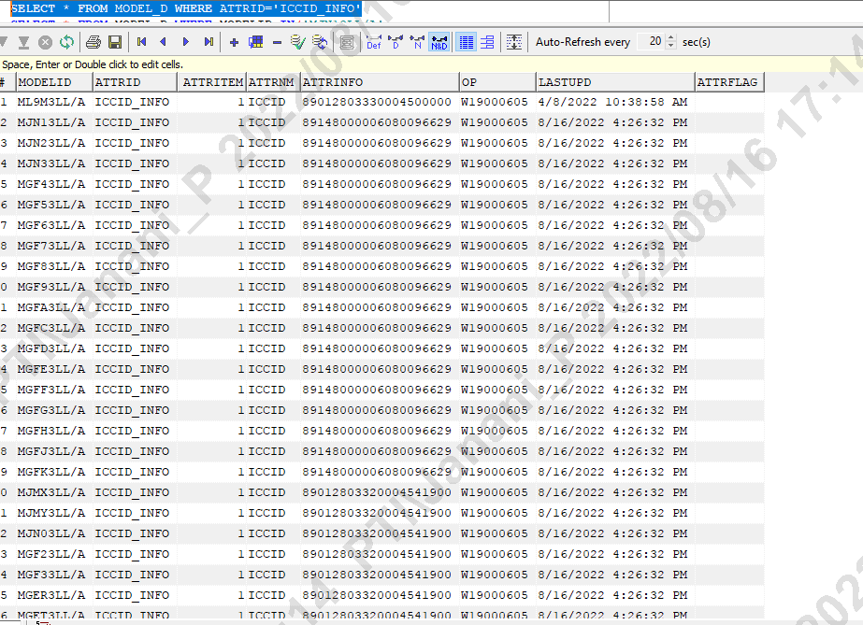
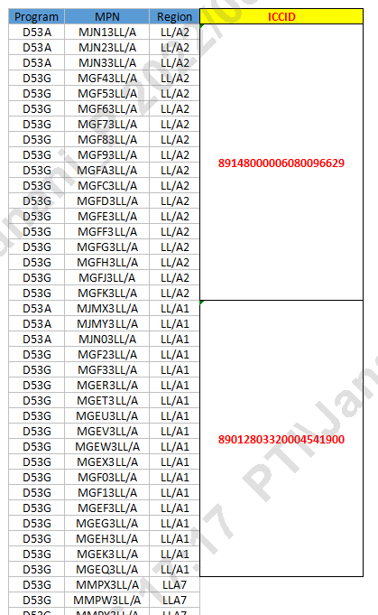
ICCID
Input received Format for ICCID
To Maintain
SELECT * FROM MODEL_D WHERE ATTRID='ICCID_INFO'

Slide 10
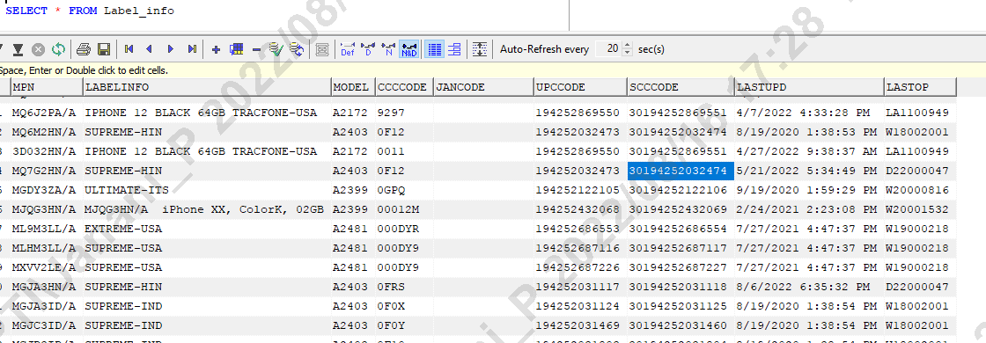
TABLES USED
1. To CHECK IOTYPE
SELECT * FROM MODEL_D WHERE MODELID IN () AND ATTRID='IOTYPE'
2. To Check Generated ISNs
SELECT * FROM MPN_ISN where type='SINGLE'
3. To Check CCCCODE
SELECT * FROM LABEL_INFO
4 DIGIT - 12 length ISN
6 DIGIT - 10 length ISN
UPCCODE - Available in FG Label
SCCCODE- Available in GS1 Label

Slide 11
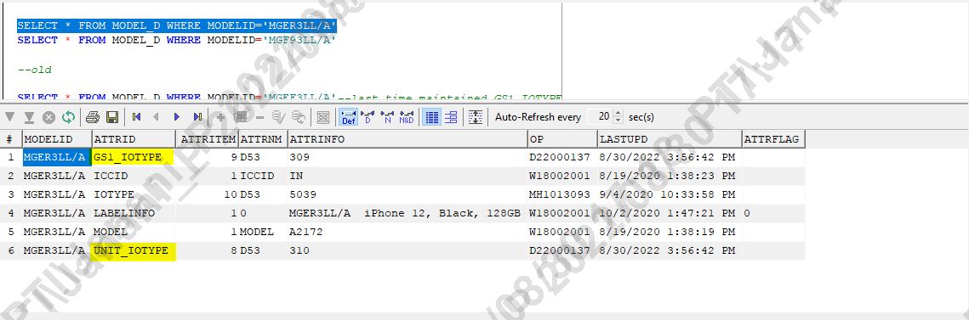
FOR NEW MPNs
1. If new MPN is taken for the first time in PTI , than its mandatory to check the GS1_IOTYPE and UNIT_IOTYPE maintained in MODEl_D table or not
2. If Not maintained mail should be send to Dustin(HQ)

Slide 12
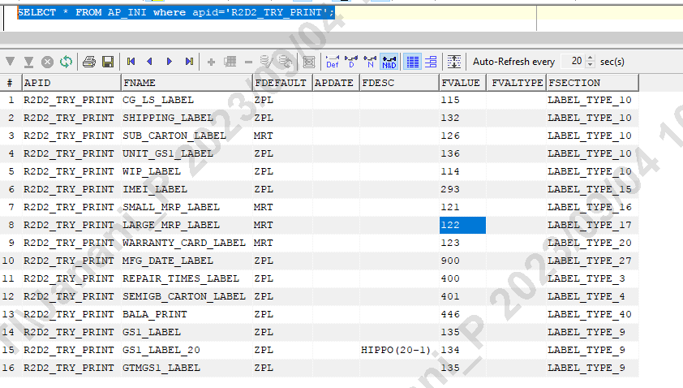
for AE testing
SELECT * FROM AP_INI where apid='R2D2_TRY_PRINT'; -- against this table need to maintain the template IOTYPE should be different from the actual production DB IOTYPE this is only for sample use to check label allignment by AE team, SFIS need to maintain only template, they will scan using FNAME, That print will be provided to AE by ME

Slide 13


